Slide 1
Survival Analysis
Tomas Bencomo and Kyle Singleton PhD

Slide 2
Roadmap
Statistics Review
What is survival analysis
Kaplan Meier Estimator
Cox PH Regression
Sample Size Considerations
Missing Data
Interpreting Statistics

Slide 3
Why Give This Talk?
“To consult the statistician after an experiment is finished is often merely to ask him to conduct a post mortem examination. He can perhaps say what the experiment died of”
- Ronald Fisher

Slide 4
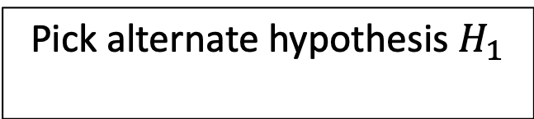
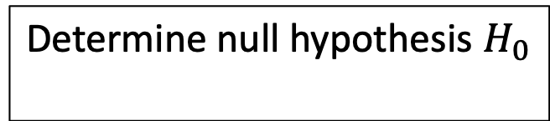
Hypothesis Testing Evaluates Evidence
Determine null hypothesis $H_{0}$
Analyze Evidence
Don’t dichotomize p-value!
Pick alternate hypothesis $H_{1}$
Compute p-value
Pick effect size of interest
Gather data

Slide 5
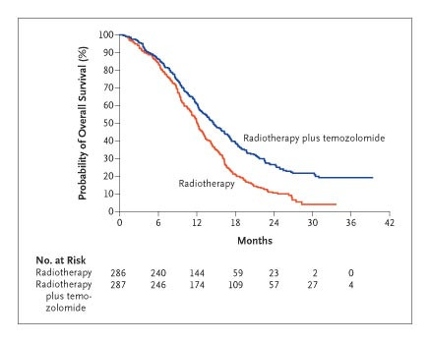
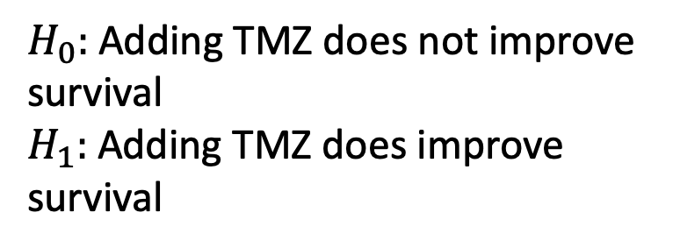
Does Treatment Affect Survival
$H_{0}:$ Adding TMZ does not improve survival
$H_{1}:$ Adding TMZ does improve survival
Stupp R et al. N Engl J Med 2005;352:987-996.

Slide 6
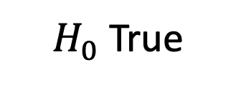
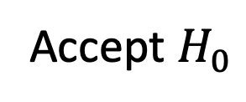
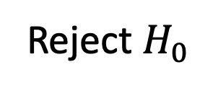
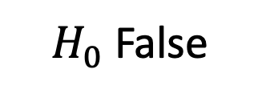
Hypothesis Tests Can Make Mistakes
$H_{0}$True
$H_{0}$False
We decide to:
Reject $H_{0}$
False Positive
Type I Error
True Negative
True Positive
False Negative
Type II Error
Accept $H_{0}$

Slide 7
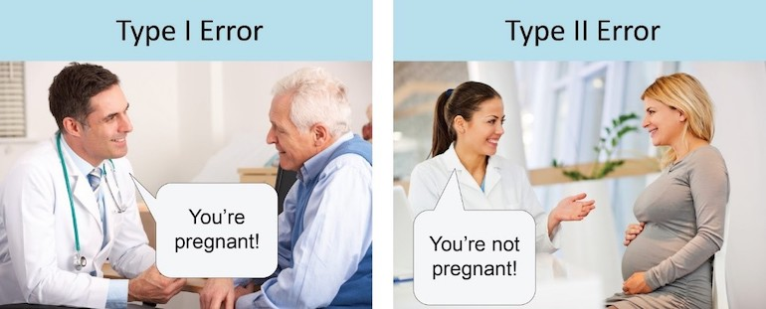

Hypothesis Tests Can Make Mistakes
$H_{0}$: The patient is not pregnant
$H_{1}$: The patient is pregnant

Slide 8
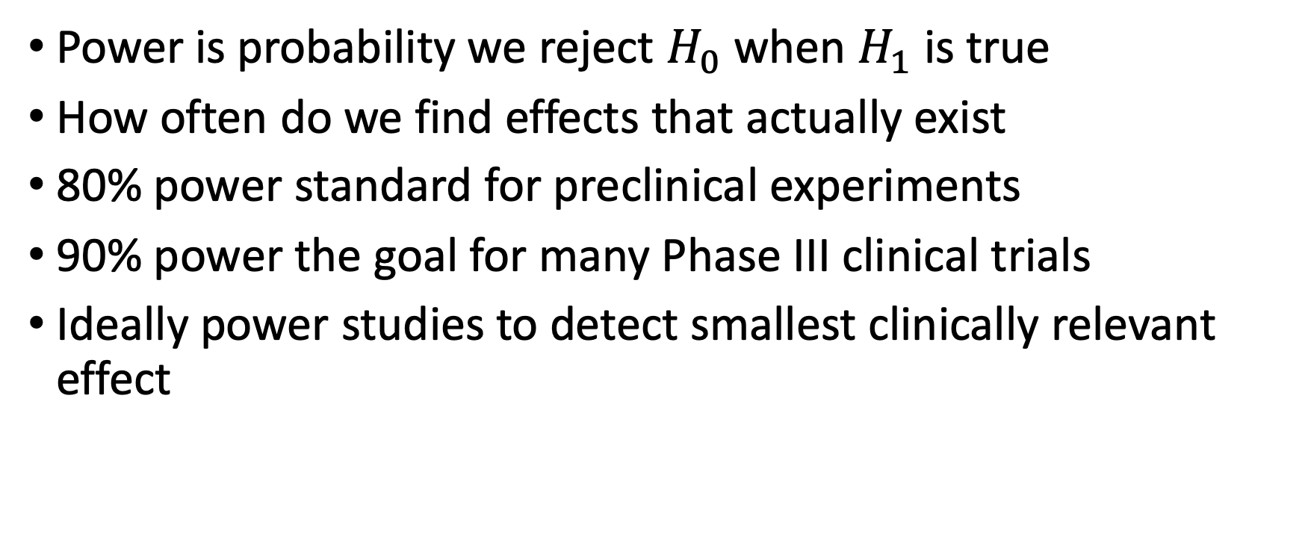
Power Tells Us About Type II Errors
Power is probability we reject $H_{0}$ when $H_{1}$ is true
How often do we find effects that actually exist
80% power standard for preclinical experiments
90% power the goal for many Phase III clinical trials
Ideally power studies to detect smallest clinically relevant effect

Slide 9
Confounding Creates Spurious Associations
TBD which example to use

Slide 10
Experimental Design Is Critical
Observational Study
Collect data without intervening
Confounding and covariate imbalance major concern
Notorious for mixed results
Randomized Trial
Randomly assign patients to different groups
Randomization deals with covariate imbalances
Gold standard of evidence in medicine

Slide 11
Observational Data Is Messy
UK Biobank: Cardiac MRI saves lives?
Has Cardiac MRI
James Pirruccello Tweetorial on UK Biobank Immortal Time Bias 2019
No Cardiac MRI

Slide 12
Observational Data Is Messy
What changed?
Count lifespan from time of MRI to death, the signal disappears
Has Cardiac MRI
Observational studies have lots of issues that statistical tests won’t catch! Don’t blindly analyze data
No Cardiac MRI

Slide 14
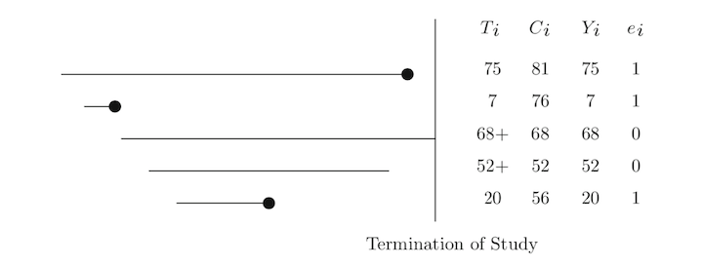
Survival Analysis
Measuring time to an event (death, myocardial infarction, recurrence)
Patients either die or are “censored”
Censored patients are lost to follow-up
Record status as 1 = event and 0 = censored
Analyzing time survived vs binary dead/alive increases power

Slide 15
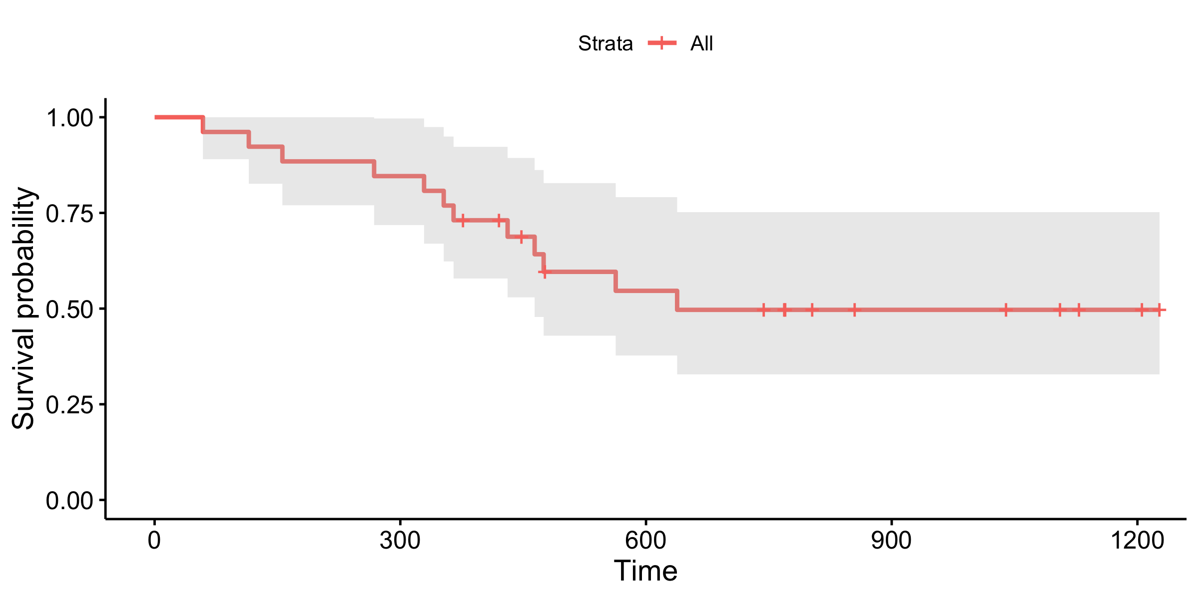
Kaplan Meier Estimates Survival
Computes probability of event at time t
Needed to handle censoring
Great for summary statistics describing patient prognosis

Slide 16
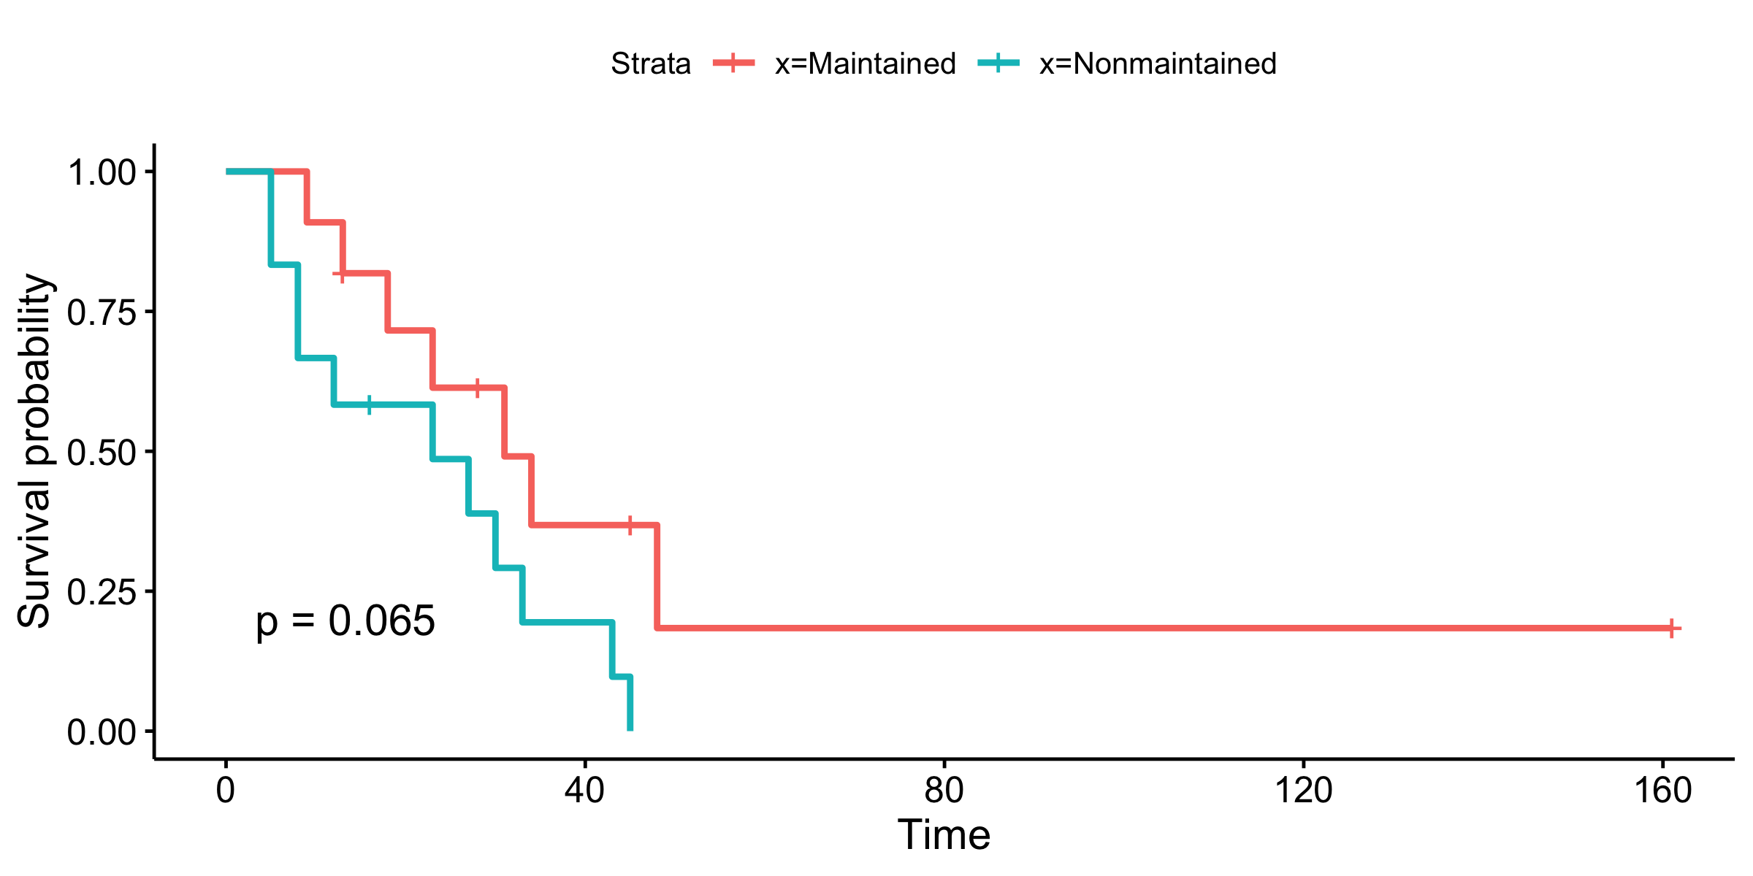
Log rank test looks for survival difference
Test to compare survival between 2 groups

Slide 17
Kaplan Meier Has Limitations
What if we need to adjust for covariates?
What if we have a continuous variable?
Where do we dichotomize?

Slide 18
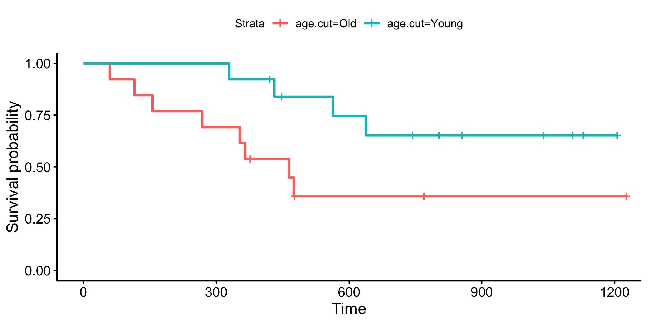
Dichotomization is the root of all evil
Discards lots of info decreasing power
Cutpoints are often arbitrary
No real reason to choose median
Cutpoints often don’t reproduce

Slide 19
Let’s Talk Iterative Kaplan Meier
Different cuts show opposite signal in two cohorts!
Iterative Kaplan Meier should be avoided
Repeated testing inflates Type I error
MCMC simulation needed to correct p-values
Dichotomization requires more patients to find effect
No statistical literature on procedure
p=0.0067
Proportion Surviving
Survival Days Since Start of CAR T
Proportion Surviving
p=0.09
Survival Days Since Start of CAR T

Slide 20
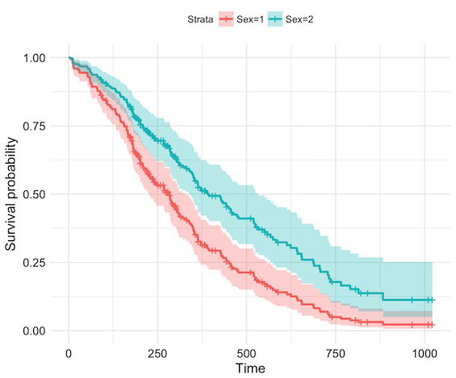
Proportional Hazards
Proportional hazards (PH): hazard ratio constant over time

Slide 21

PH: Don’t Cross Streams (Curves)!
Steve Simon PhD – The Analysis Factor

Slide 22
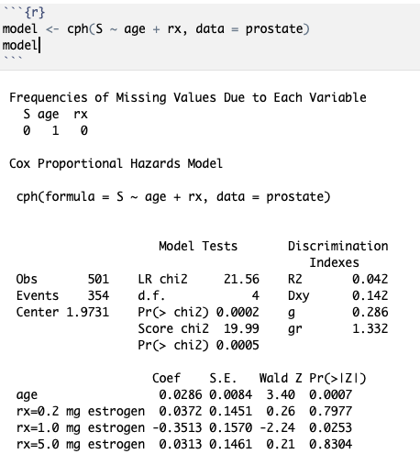
Cox Regression Address Kaplan Meier Limitations
Multiple regression model
Model continuous variables
Account for nonlinearity
Adjust for covariates
Make risk predictions
Use rms package for R

Slide 23
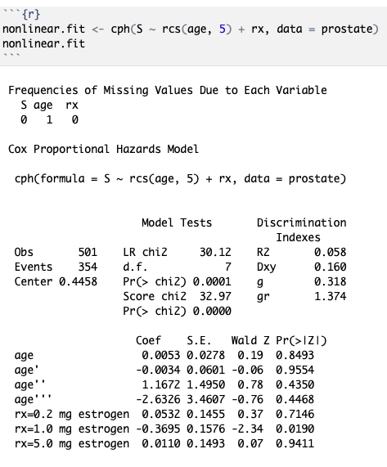
Modeling Nonlinear Effects
Restricted cubic splines relax linearity assumptions
Use rcs() function in R
Number of knots determine how well spline fits data
Use 3 to 5 knots depending on how much data

Slide 24
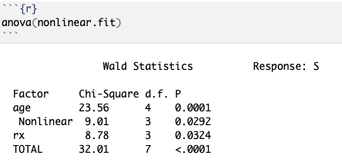
Interpreting Cox Model
Use anova() to test if variable is associated with prognosis
Only gives p-value not effect size
Need to plot predictor vs HR for nonlinear variables to see effect

Slide 25
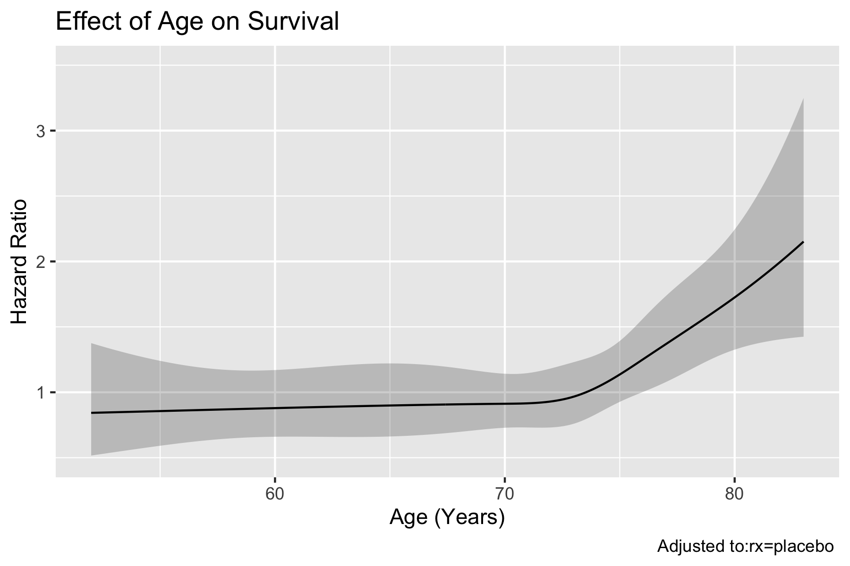
Plotting Predictor vs HR
HR = 1: No difference
HR < 1: Better survival
HR > 1: Worse survival
Beware HR vs ln(HR) scale

Slide 26
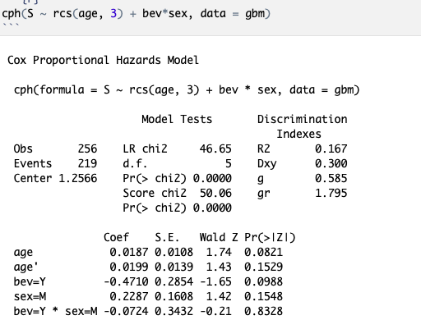
Patient Heterogeneity: Subgroup Analysis
Different treatment effect in different groups
Use interaction term to test for heterogeneity
Check for significance with anova()
If significant must interpret effects differently!

Slide 27
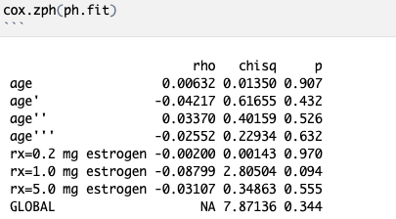
All Models Have Assumptions
Cox assumes PH
If PH is wrong, model can be invalid
If PH not met:
Try splines for continuous variables
Stratify by variable
Time dependent interaction
Switch to AFT models

Slide 29
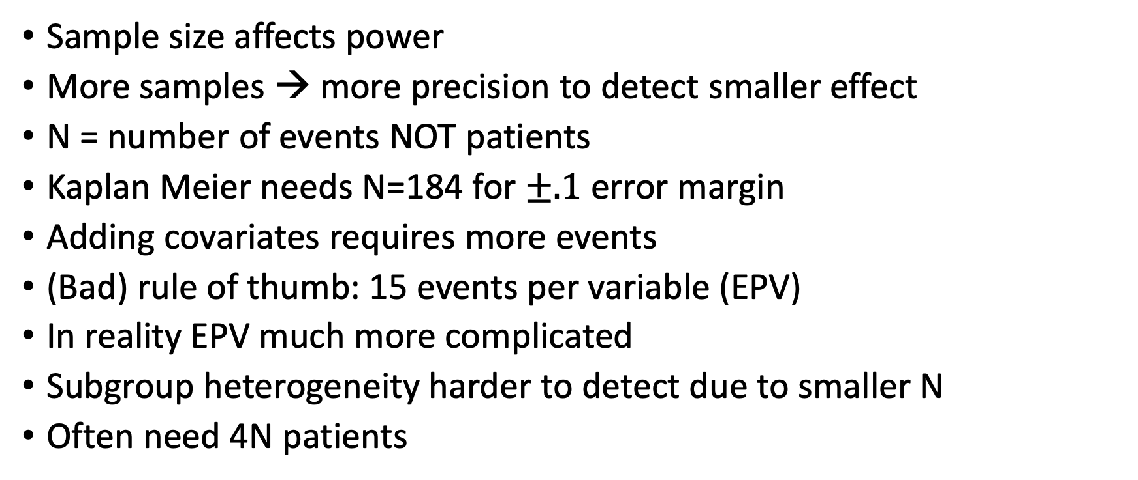
Sample Size Is King
Sample size affects power
More samples → more precision to detect smaller effect
N = number of events NOT patients
Kaplan Meier needs N=184 for $±.1$ error margin
Adding covariates requires more events
(Bad) rule of thumb: 15 events per variable (EPV)
In reality EPV much more complicated
Subgroup heterogeneity harder to detect due to smaller N
Often need 4N patients

Slide 30
Let’s Get Real About Power
Assume treatment improves survival by 25% (HR = .75)
GBM almost always lethal - assume 90% of patients die
50-50 split between treatment and control groups
Need lots of patients to have any chance of finding effect!
Sample | Power
20 | 9%
100 | 25%
400 | 73%
800 | 95%
http://powerandsamplesize.com/Calculators/Test-Time-To-Event-Data/Cox-PH-2-Sided-Equality

Slide 31
What Variables Do We Include in Our Model?
Sample size can limit number of variables to include
Variable selection procedures can impact inference
Select features incorrectly → exaggerate results
https://xkcd.com/1838/

Slide 32
Univariate Feature Selection is Bad
Common to screen variables with univariate Cox
People then only include significant variables in final model
This is a form of stepwise variable selection
9/10 of statisticians agree: don’t use stepwise variable selection!
Attiyeh et al. 2004

Slide 33
Stepwise Selection Wrecks Inference
Univariate selection highly dataset dependent
Doesn’t adjust for covariates – potential for misleading signal
Univariate selection overexaggerates p-values and CIs in “full” model
Little statistical theory to support

Slide 34
How To Choose Features
Proper selection strategies:
Domain expert specifies relevant variables
Use all variables and apply shrinkage
Data reduction blinded to response
Leave insignificant in model – still add to predictions
Think about relevant confounders
Don’t Make Me Choose!
Akash Desarda – TowardsDataScience

Slide 35
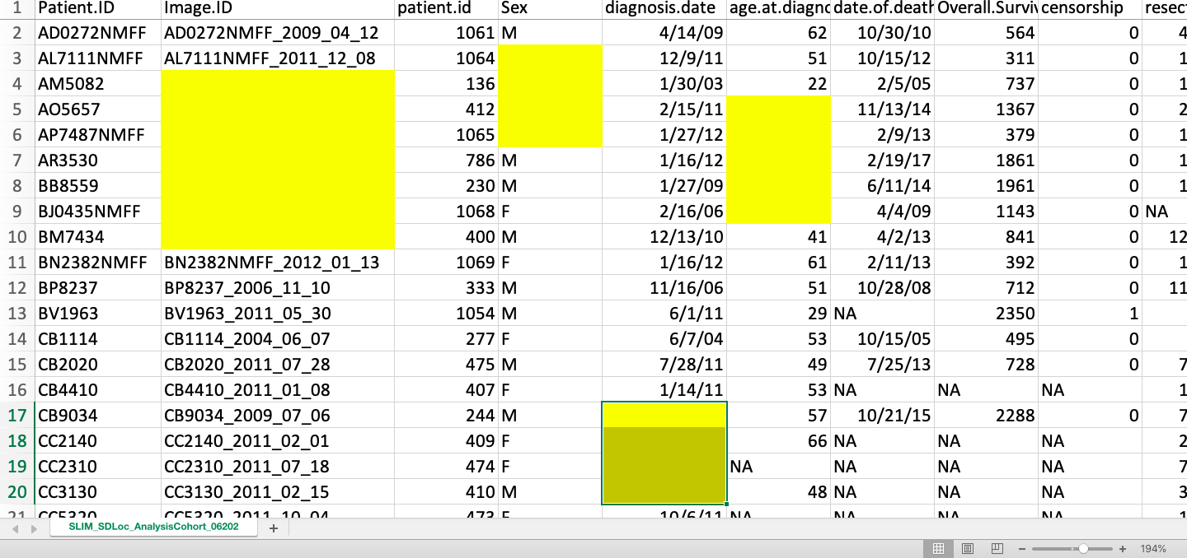
Don’t Discard Patients with Missing Data

Slide 36
Don’t Discard Patients Missing Data
Missing data decreases sample size
Larger sample → better power
Ask why this data is missing – bias may be present
Example: Patients missing labs b/c died before labs could be collected
Simply excluding these patients could bias results
Before fixing data, explore patterns in missing variables
Think about if data is missing at random (MAR) or informative missing (MI)

Slide 37
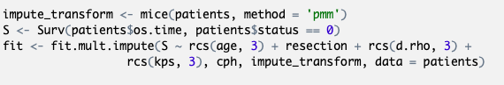
Imputation Gives Us The Power
Idea: Can we guess these missing values?
Imputation lets us guess data that is MAR
Better to guess missing values than reduce sample size
MICE imputation guesses data from non-missing data
Imputing multiple times maintains inference validity

Slide 38
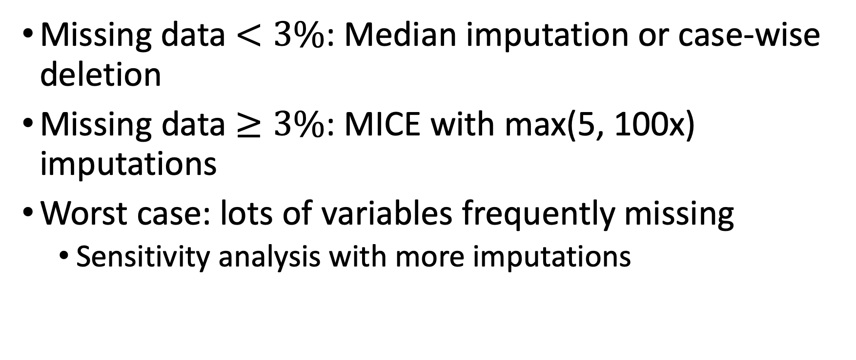
Imputation Guidelines
Missing data $<3\%$: Median imputation or case-wise deletion
Missing data $≥3\%$: MICE with max(5, 100x) imputations
Worst case: lots of variables frequently missing
Sensitivity analysis with more imputations

Slide 39
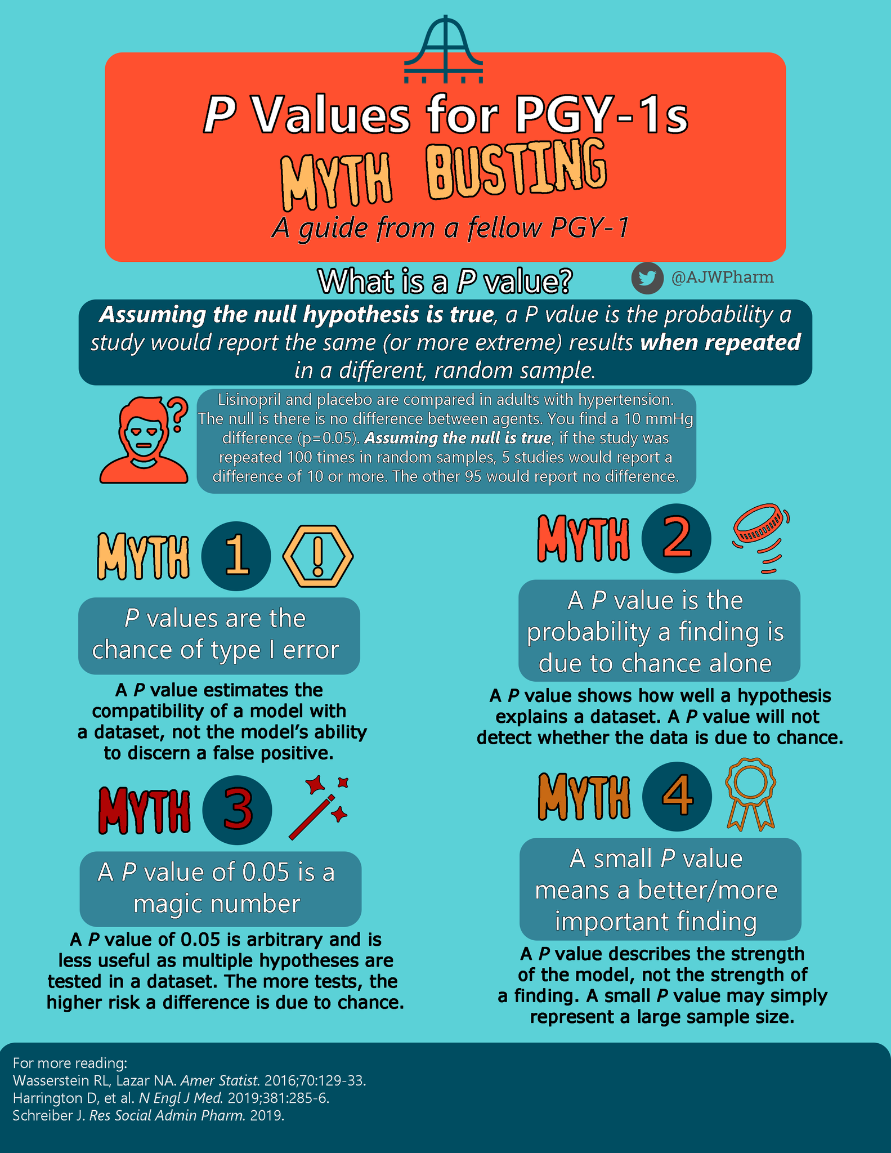
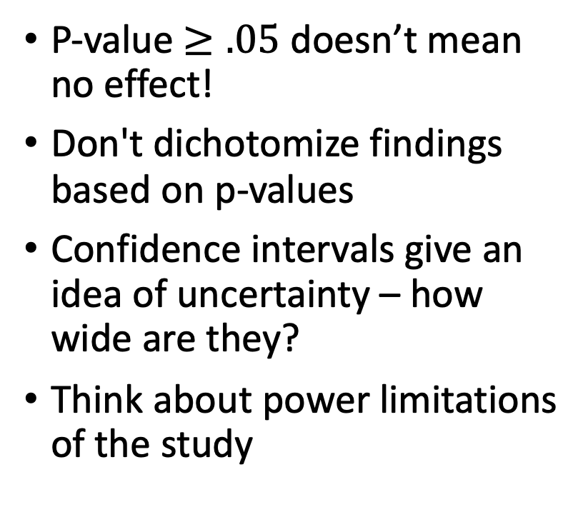
Interpreting Results
P-value $≥.05$ doesn’t mean no effect!
Don't dichotomize findings based on p-values
Confidence intervals give an idea of uncertainty – how wide are they?
Think about power limitations of the study
Andy Webb PharmD on Twitter 2019

Slide 40
Reporting Results
Report confidence intervals
Don’t dichotomize findings – use CIs
Report prespecified vs exploratory analyses
Need a graphic here

Slide 41
There’s Always More Out There…
Evaluating biomarker efficacy
Validating prediction models
Data reduction strategies
Modeling in high dimensional spaces
Simulation experiments and power calculations
Randomized controlled trial design
Multiple comparisons correction
Data visualization
Ask us if you want more info on any of these topics!

